Slide 1
Tableau Project
THIS PROJECT IS BASED ON DEATILED ATTRIBUTES FOR EVERY PLAYER REGISTERED IN THE LATEST EDITION OF FIFA-19 DATABASE.
THIS DATASETS CONSIST OF 63 COLUMNS & 1973ROWS
FROM THIS DATASET, THE FIELDS WHICH ARE USED AS FOLLOWS :-
NAME , AGE , NATIONALITY , OVERALL , POTENTIAL , VALUE , WAGE , CLUB , PREFERRED FOOT , INTERNATIONAL REPUTATION, BODY TYPE , POSITION ,JOINED YEAR , CONTRACT VALID YEAR , ACCELERATION , PENALTIES, RELEASE CLAUSE

Slide 2
PROBLEM STATEMENTS
NATION WISE PLAYER COUNT WRT THEIR AVG.POTENTIAL
PLAYERS PREFFERED POSITION WRT OVERALL RATING,BODY TYPE
PREFERRED FOOT BY PLAYERS WRT ACCELERATION
HIGHEST PAID PLAYERS WRT VALUE,WAGE,AGE
JOINED & CONTRACT VALID YEAR OF PLAYERS
PLAYERS RELEASE CLAUSE & CLUBS WRT OVERALL RATINGS
TOP 10 PLAYERS INTERNATIONAL REPUTATION WRT WAGE,PENALTY RECORD
AGE WISE DISTRIBUTION OF PLAYERS

Slide 3
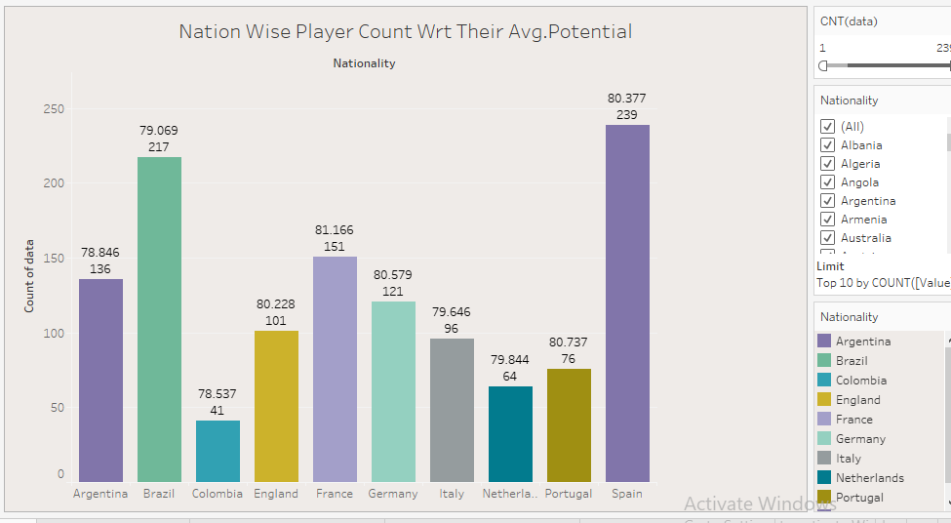
Nation wise player count

Slide 4
Nation Wise Count Of Player Wrt Their Avg. Potential - Story
SPAIN COUNTRY HAS HIGHEST NO OF PLAYERS – 239 AVG. POTENTIAL – 80.37
COLOMBIA COUNTRY HAS LOWEST NO OF PLAYERS – 41 AVG. POTENTIAL – 78.53
INSIGHTS –
SPAIN COUNTRY HAS HIGHEST NO OF PLAYERS BUT ITS AVG POTENTIAL OF PLAYERS IS LESS THEN FRANCE
FRANCE COUNTRY HAVE HIGHEST POTENTIAL – 81.16

Slide 5
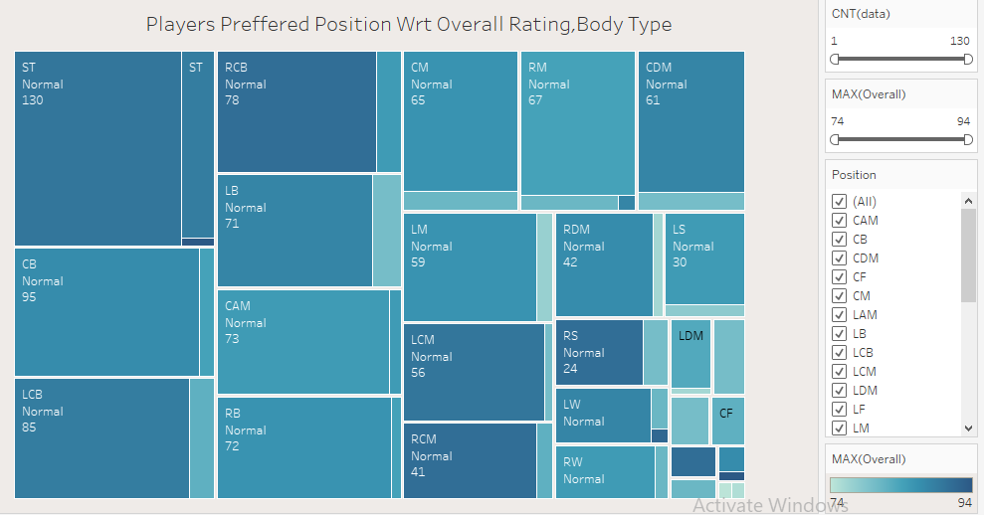
PLAYERS PREFFERED POSITION WRT OVERALL RATING,BODY TYPE
MOST PREFERRED POSITION BY FIFA PLAYER IS ST. (130 PLAYER WITH STRIKER POSITION) AND BODY TYPE IS NORMAL
LOWEST PREFERRED POSITION IS RF.(3 PLAYER WITH RIGHT FORWARD POSITION)

Slide 6
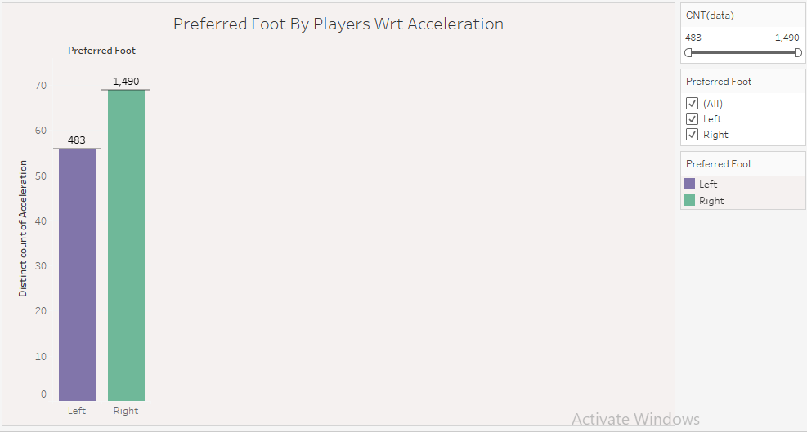
PREFERRED FOOT BY PLAYERS

Slide 7
PREFERRED FOOT BY PLAYERS WRT ACCLERATION- STORY
MAXIMUM PLAYERS PREFERRED RIGHT FOOT – 1490
PLAYERS DISTINCT COUNT OF ACCELERATION WHO PREFERRED RIGHT FOOT - 69
MINIMUM PLAYERS PREFERRED LEFT FOOT – 483
PLAYERS DISTINCT COUNT OF ACCELERATION WHO PREFERRED LEFT FOOT - 56

Slide 8
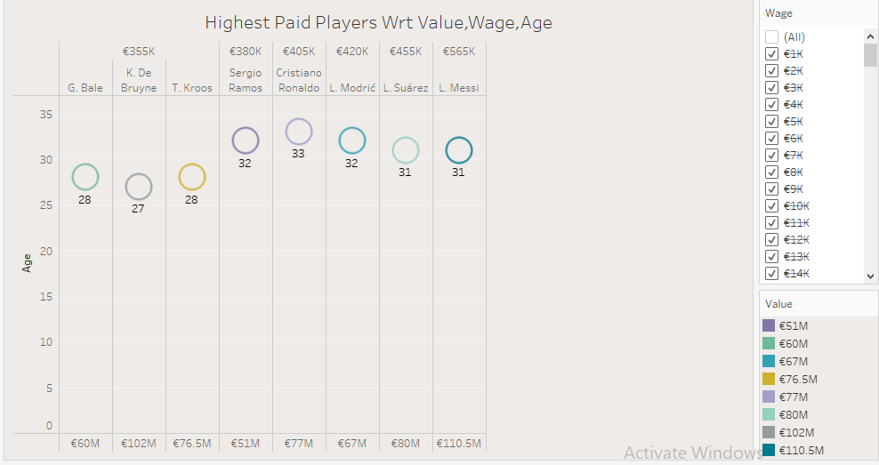
Highest Paid Players Wrt Value,Wage,Age

Slide 9
HIGHEST PAID PLAYERS WRT VALUE, WAGE,AGE - STORY
THE HIGHEST PAID PLAYER IS LIONEL MESSI WITH WAGE €565K & VALUE IS €110.5M.
THE SECOND HIGHEST PAID PLAYER IS L. SAUREZ WITH WAGE €455K & VALUE IS €80M.
L.MODRIC , CRISTIANO RONALDO , SERGIO RAMOS ALSO THE HIGHEST PAID PLAYERS.

Slide 10
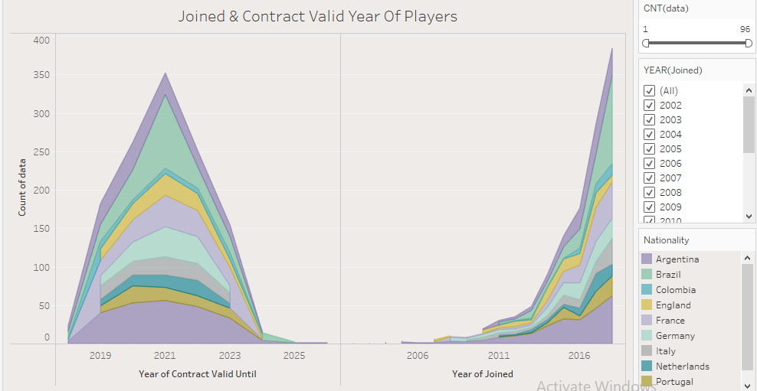
JOINED & CONTRACT VALID YEAR OF PLAYERS
VERY LESS NO OF PLAYERS JOINED FIFA IN 2006-2013.
AFTER 2017 GROWTH IN FIFA PLAYERS INCREASED.
MOST OF THE PLAYERS JOINED FIFA IN 2018.
MOST OF THE PLAYERS CONTRACT VALID UNTIL 2021.

Slide 11
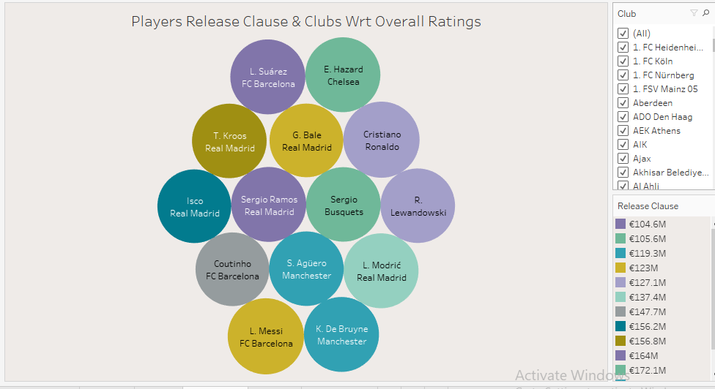
Players Release Clause & Clubs Wrt Overall Ratings
AMONGST TOP PLAYERS “LIONEL MESSI” HAS HIGHEST RELEASE CLAUSE VALUE – €226.5M AND HE IS A MEMBER OF “FC BARCELONA” CLUB WITH OVERALL RATING – 94.
“SERGIO RAMOS” HAS LOWEST RELEASE CLAUSE VALUE – €104.6 M AND HE IS A MEMBER OF “REAL MADRID” CLUB WITH OVERALL RATING – 91.

Slide 12
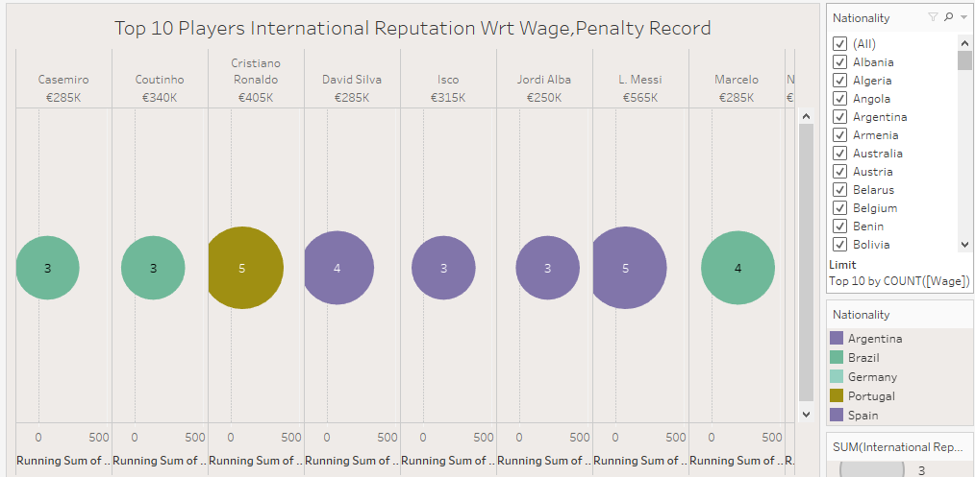
TOP 10 PLAYERS INTERNATIONAL REPUTATION
WRT WAGE,PENALTY RECORD
AMONGST TOP 10 PLAYERS WRT WAGE AND PENALTY RECORD “LIONEL MESSI” & “CRISTIANO RONALDO” HAS HIGHEST INTERNATIONAL REPUTATION.
L.MESSI – WAGE - €565K , PENALTY RECORD – 75 , REPUTATION – 5
C.RONALDO - WAGE - €405K , PENALTY RECORD – 85,REPUTATION – 5
“JORDI ALBA” HAS HIGHEST PENALTY RECORD – 210 REPUTATION- 3

Slide 13
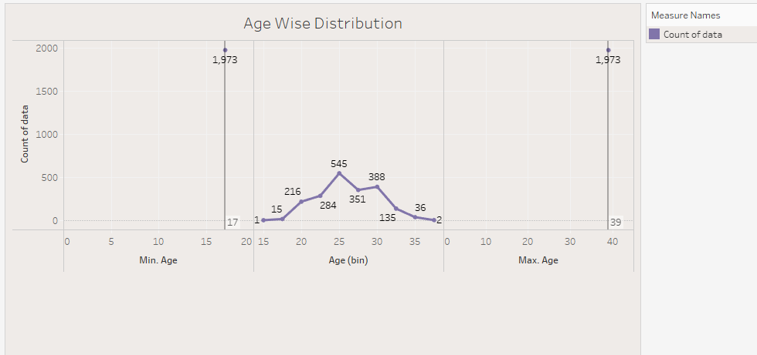
AGE WISE DISTRIBUTION OF PLAYERS
MOST FOOTBALL PLAYERS IN FIFA 19 ARE 25 YEARS OLD.
WHILE YOUNGEST ARE 17 YEARS OLD AND THE OLDEST ARE 39 YEARS OLD.

Slide 14
SOURCE DATA
DATASET
https://www.kaggle.com/karangadiya/fifa19
TABLEAU PUBLIC SOURCE
https://public.tableau.com/app/profile/supriya.ransing/viz/FIFA19_TABLEAU_PROJECT/Dashboard2
VIDEO PRESENTATION LINK
https://drive.google.com/file/d/1brJF1i2CCjc3ySBKwQPvREoPG1gZo7Xk/view?usp=sharing

Slide 15
CONCLUSION
NATION WISE PLAYER COUNT WRT THEIR AVG.POTENTIAL
SPAIN COUNTRY HAS HIGHEST NO OF PLAYERS – 239 AVG. POTENTIAL – 80.37
COLOMBIA COUNTRY HAS LOWEST NO OF PLAYERS – 41 AVG. POTENTIAL – 78.53
PLAYERS PREFFERED POSITION WRT OVERALL RATING,BODY TYPE
MOST PREFERRED POSITION BY FIFA PLAYER IS ST. (130 PLAYER WITH STRIKER POSITION) AND BODY TYPE IS NORMAL
LOWEST PREFERRED POSITION IS RF.(3 PLAYER WITH RIGHT FORWARD POSITION)
PREFERRED FOOT BY PLAYERS WRT ACCLERATION
MAXIMUM PLAYERS PREFERRED RIGHT FOOT – 1490 ACCELERATION - 69
MINIMUM PLAYERS PREFERRED LEFT FOOT – 483 ACCELERATION – 56
HIGHEST PAID PLAYERS WRT VALUE,WAGE,AGE
THE HIGHEST PAID PLAYER IS LIONEL MESSI WITH WAGE €565K & VALUE IS €110.5M.
THE SECOND HIGHEST PAID PLAYER IS L. SAUREZ WITH WAGE €455K & VALUE IS €80M.
L.MODRIC , CRISTIANO RONALDO , SERGIO RAMOS ALSO THE HIGHEST PAID PLAYERS.

Slide 16
CONCLUSION
JOINED & CONTRACT VALID YEAR OF PLAYERS
MOST OF THE PLAYERS JOINED FIFA IN 2018.
MOST OF THE PLAYERS CONTRACT VALID UNTIL 2021.
PLAYERS RELEASE CLAUSE & CLUBS WRT OVERALL RATINGS
AMONGST TOP PLAYERS “LIONEL MESSI” HAS HIGHEST RELEASE CLAUSE VALUE – €226.5M AND HE IS A MEMBER OF “FC BARCELONA” CLUB WITH OVERALL RATING – 94.
TOP 10 PLAYERS INTERNATIONAL REPUTATION
WRT WAGE,PENALTY RECORD
L.MESSI – WAGE - €565K , PENALTY RECORD – 75 , REPUTATION – 5
C.RONALDO - WAGE - €405K , PENALTY RECORD – 85,REPUTATION – 5
“JORDI ALBA” HAS HIGHEST PENALTY RECORD – 210 REPUTATION- 3
AGE WISE DISTRIBUTION OF PLAYERS
.
MOST FOOTBALL PLAYERS IN FIFA 19 ARE 25 YEARS OLD.
WHILE YOUNGEST ARE 17 YEARS OLD AND THE OLDEST ARE 39 YEARS OLD

Slide 17
DASHBOARD

Slide 18
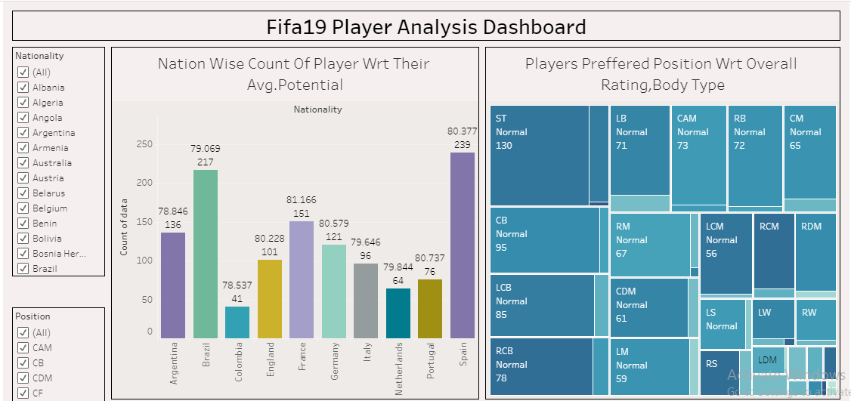

Slide 19
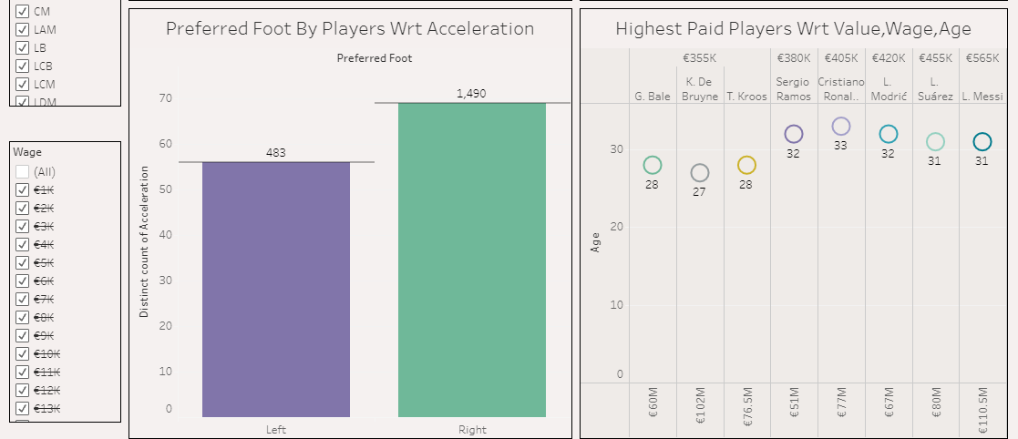

Slide 20
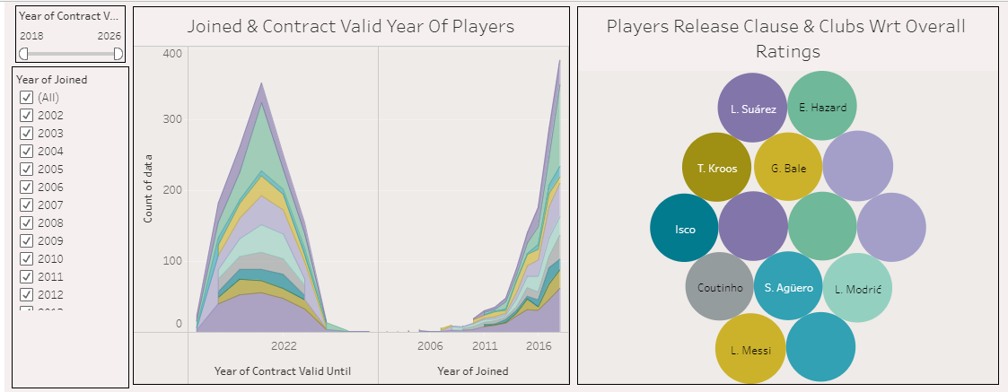

Slide 21
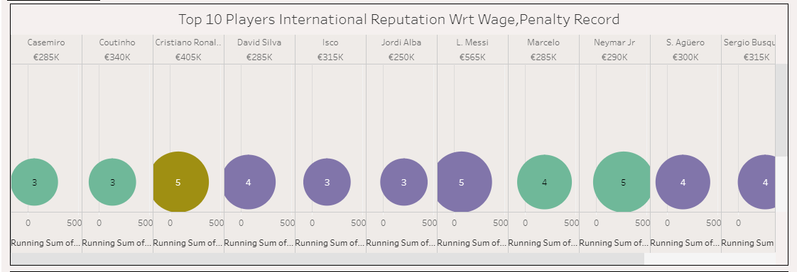

Slide 22
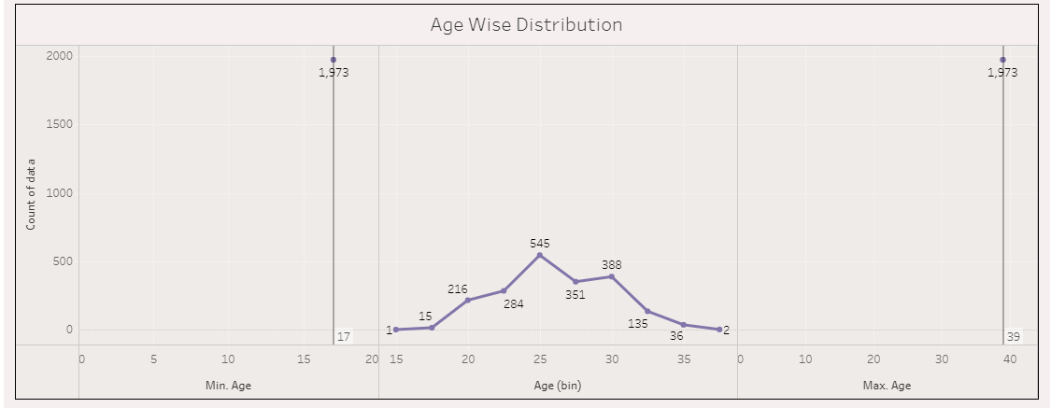

Slide 23
THANK YOU

